Slide 1
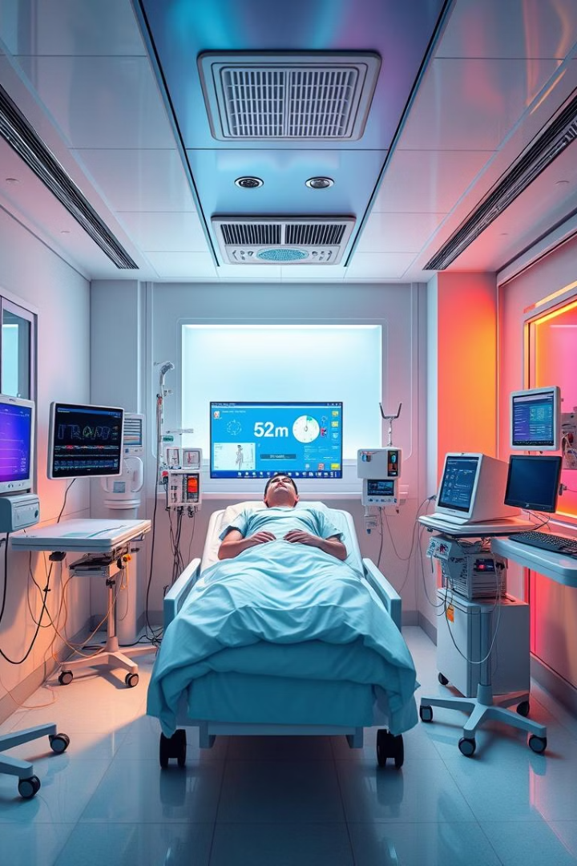
Autonomous ICU Patient Monitoring
Transforming ICU care through real-time, AI-powered patient monitoring.
Project title : Autonomous ICU Patient Monitoring
Team Name : Smart Solutions
Team Id : Team 01
Team Leader : Naresh K
Team Members : Mohammed Jubair, Kathiravan, Jaganraj

Slide 2
The Problem: Gaps in ICU Monitoring
Limited Resources
Missed Early Warning Signs
Nurses are often stretched thin, making it difficult to constantly monitor patients and detect subtle changes in their condition.
Delayed recognition of distress can lead to complications and longer recovery times, negatively impacting patient outcomes.

Slide 3
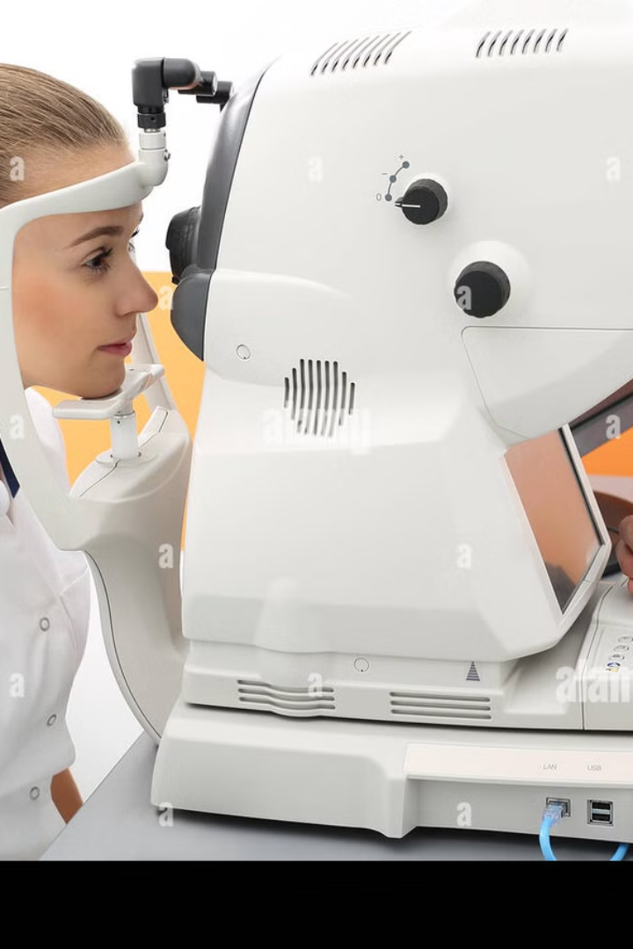
Our Solution:
AI-powered Patient Monitoring
Continuous Monitoring
Real-Time Alerts
Computer vision algorithms analyze patient behavior, detecting subtle changes in posture, movement, and facial expressions that may indicate distress.
When potential issues are detected, the system triggers immediate alerts, enabling nurses to intervene promptly and provide timely care.

Slide 4



Technical Approach
Computer Vision
Machine Learning
Our system uses advanced computer vision algorithms to analyze patient data captured by in-room cameras.
Machine learning models are trained on vast datasets of patient data to identify patterns and predict potential issues.

Slide 5
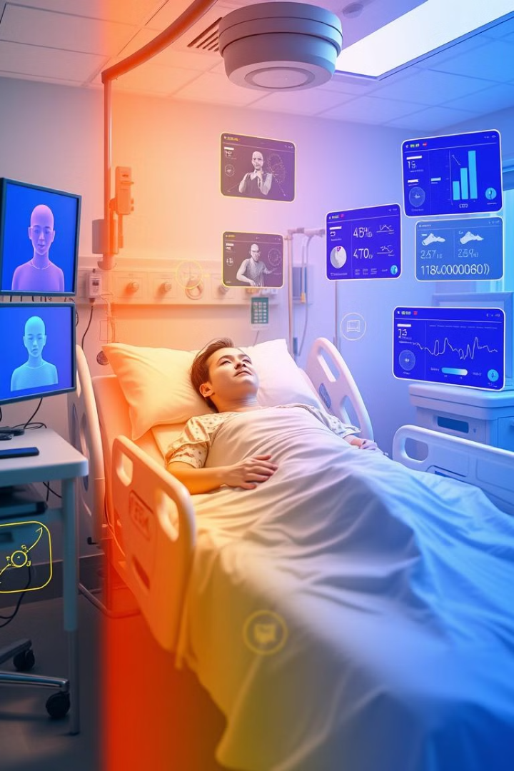
Business Potential: Impact on Healthcare
10%
Reduced Costs
Proactive interventions can minimize the risk of complications and reduce the need for expensive treatments.
20%
Improved Outcomes
Early detection of distress leads to faster intervention, potentially reducing length of stay and improving patient recovery.
30%
Enhanced Efficiency
By automating monitoring tasks, our system frees up nursing staff to focus on more complex patient care needs.

Slide 6

Impact and Future Developments
Autonomous ICU patient monitoring has the potential to revolutionize healthcare by improving patient outcomes, reducing costs, and enhancing the efficiency of medical professionals.
Future developments include incorporating additional data sources, such as vital signs and wearable sensors, to further enhance the system's accuracy and capabilities.

